Slide 1

Unit 8

Slide 2
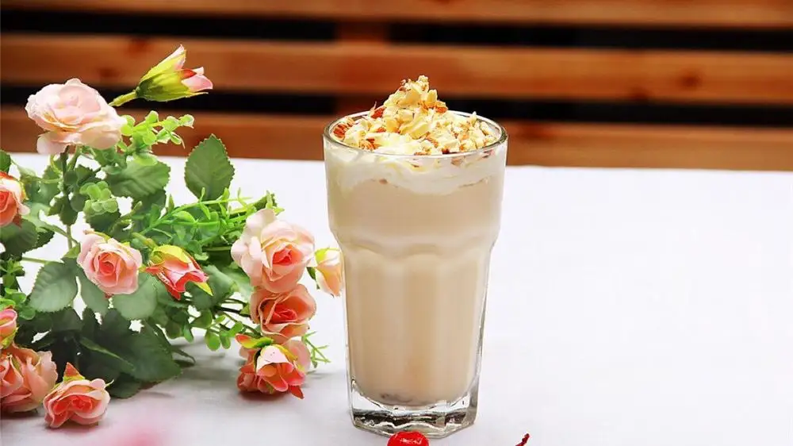
Unit 8
How do you make a banana milk shake?

Slide 3




Slide 4


How do you make a banana milk shake?
peel
1. First, _______ (剥皮；去皮) the bananas.
2. Next, ______ (把……放入) the bananas _____ the blender.
3. Then, _____ the milk _____(把……倒入) the blender.
4. Finally, _____ _____(打开) the blender.
put
in/into
pour into
turn on

Slide 5

祈使句
定义：以动词原形引导的，表示请求、命令、许可、劝告、建议、禁止等的句子。
特点：
以动词原形/Don’t +动词原形开头, 没有时态和数的变化；
暗含的主语是you, 但通常省略。
肯定句：Turn on the fire.
打开火(打开煤气炉)。
Be/Keep quiet, please.
请保持安静。
否定句: Don’t open the window, please.
请不要开窗。
Don’t be late for class.
上课不要迟到。

Slide 6



Circle the correct word in each question.
1. How (much/many) bananas do we need?
2. How (much/many) sugar do we need?
3. How (much/many) bread do we need?
4. How (much/many) tomatoes do we need?
5. How (much/many) cheese do we need?
6. How (much/many) yogurt do we need?

Slide 7
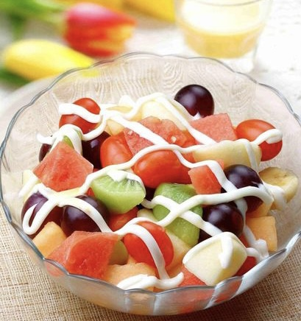
——What do you see?
——We see ...
How do we make a fruit salad?
a fruit salad
水果沙拉: 将不同的水果切成丁状/方块，摆放在盘子里，浇上配酱(如沙拉酱 /酸奶 /蜂蜜等)，进行搅拌就完成了。

Slide 8

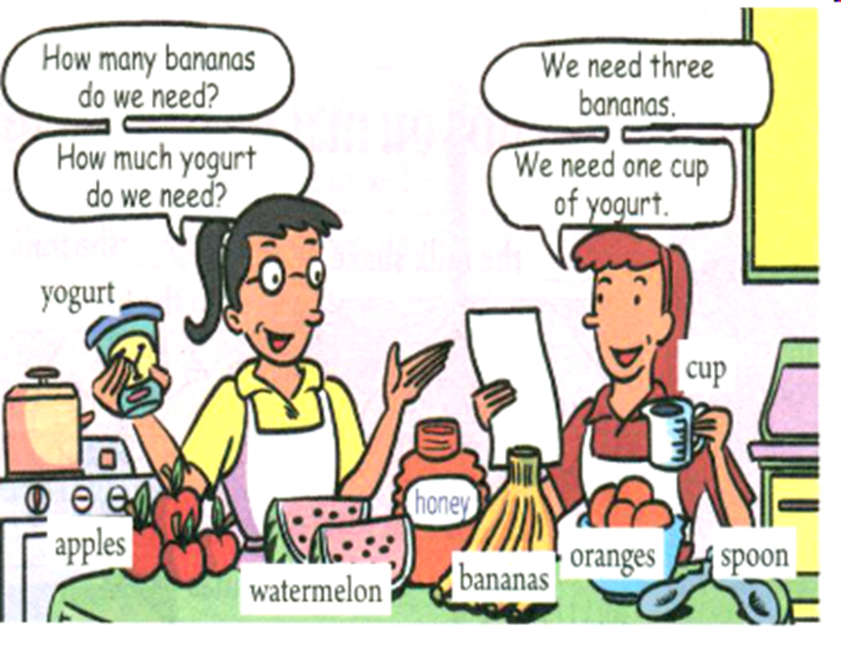
Look at the picture about the ingredients(原料) of making a fruit salad. What are they? Complete the chart with the ingredients.
How many | bananas,
How much | yogurt,
watermelons,
apples,
oranges
honey

Slide 9


Listen to the conversation about making a fruit salad.
Write the ingredients(原料) under the correct amount(数量) in the chart.
one | two | three | one cup | two spoons
watermelon
apples
bananas
yogurt
honey
orange

Slide 10
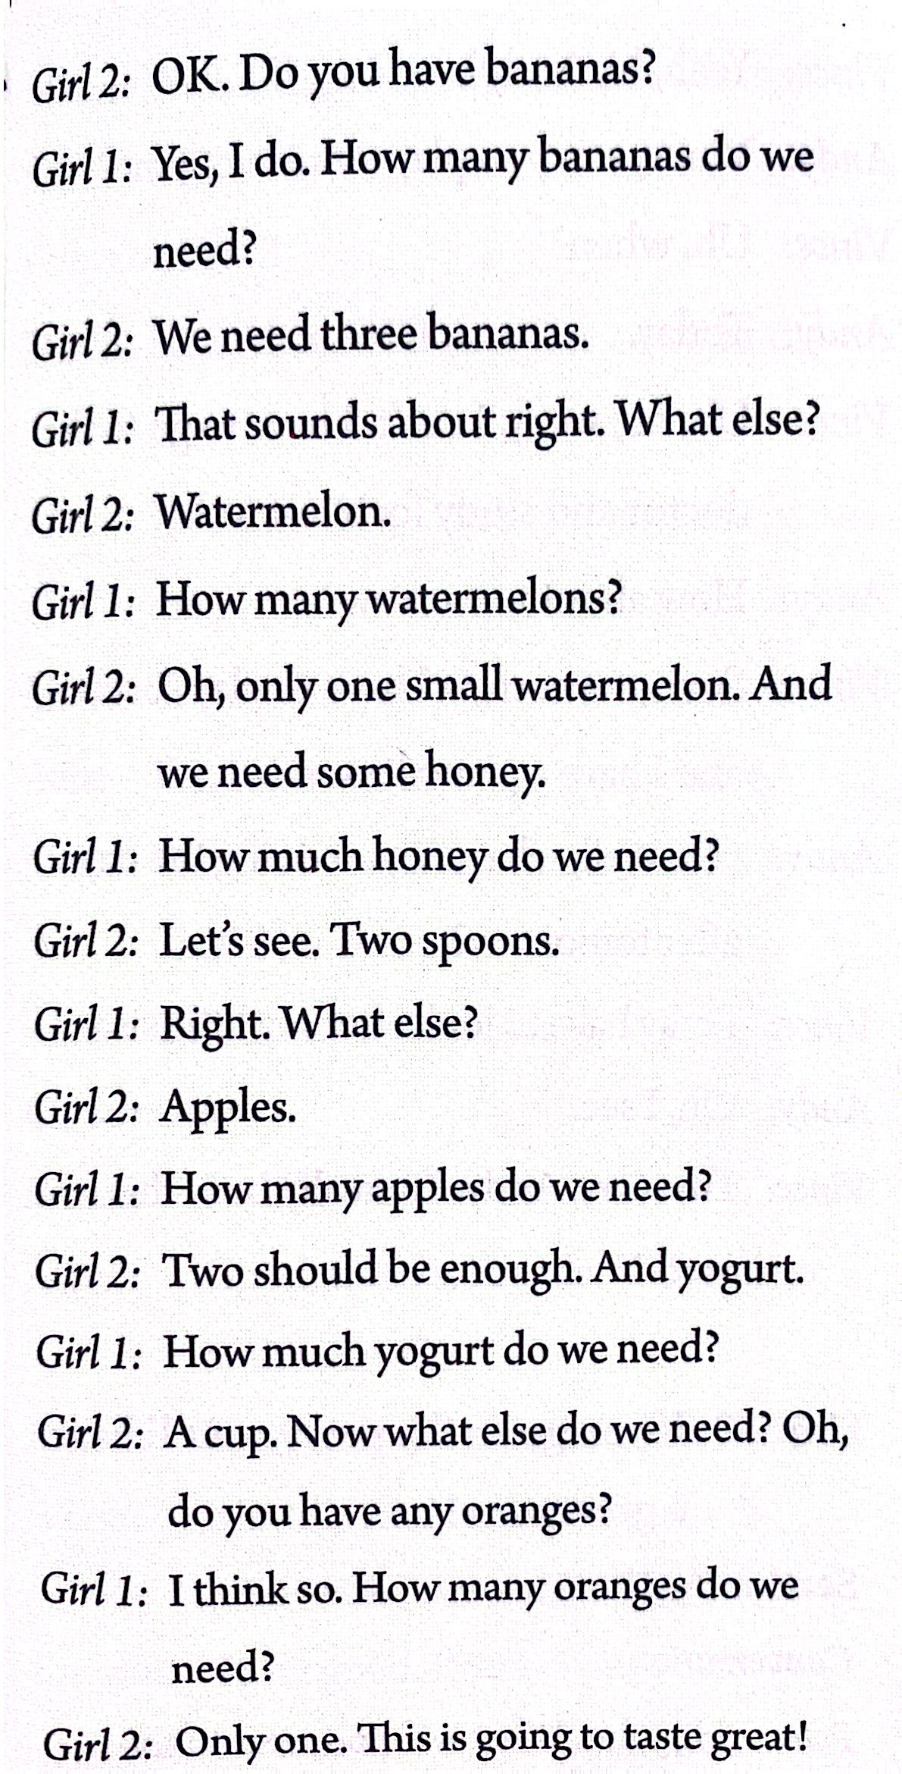
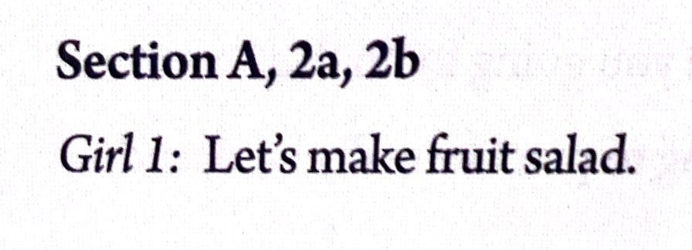

Slide 11
The ingredients(原料) and process(过程) of making a fruit salad.
ingredient原料 | apple | watermelon | banana | orange | yogurt | honey
amount 数量
2 1 3 1 one cup two spoons
the fruit
First, wash ______________.
Then, peel ______________.
Then, cut up ______________.
Then, put ______________ in ______________.
Next, pour ______________ into ______________.
Finally, mix ______________ and ______________.
the fruit
the fruit
the fruit a bowl
one cup of yogurt and two spoons of honey
the fruit
the fruit
the yogurt and honey

Slide 12

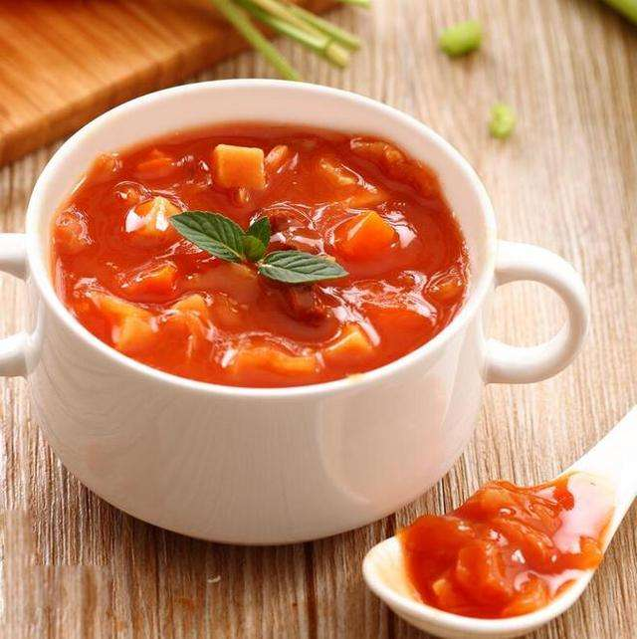
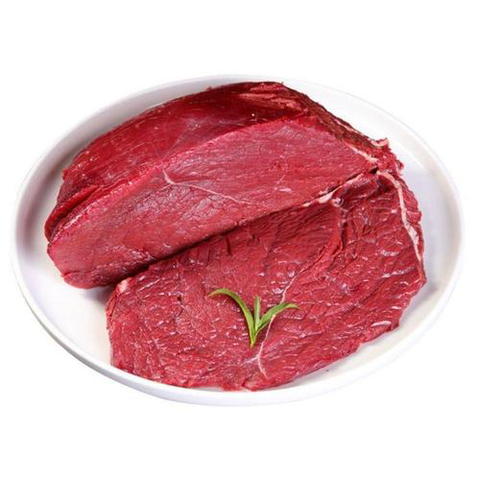
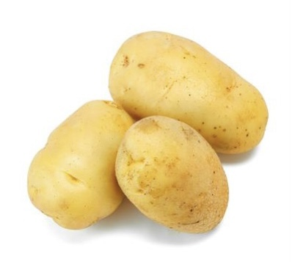
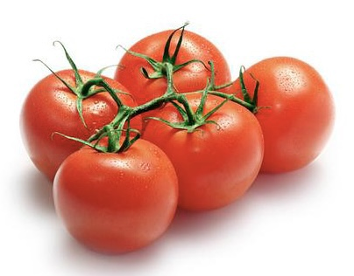
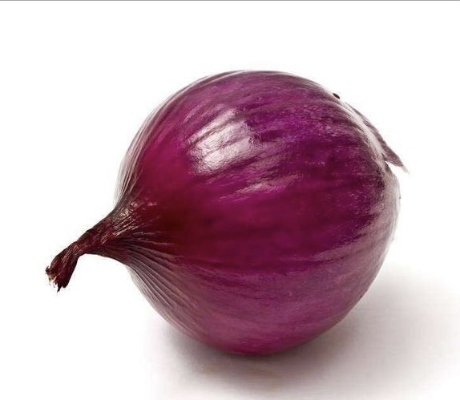
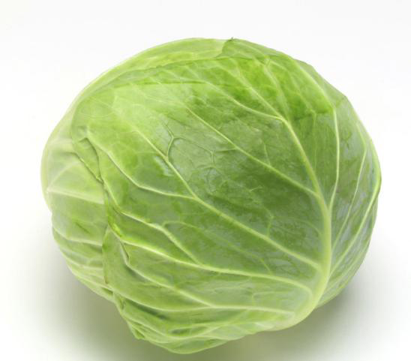
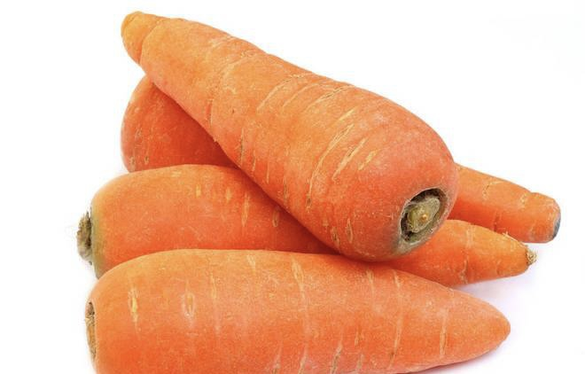
Read the conversation and think about the questions.
1. What’s the name of this food?
It’s Russian soup.
2. What ingredients(原料) are there in this food?
There is some beef, one cabbage, four carrots, three potatoes, five tomatoes and an onion.
3. How do we make this food?

Slide 13
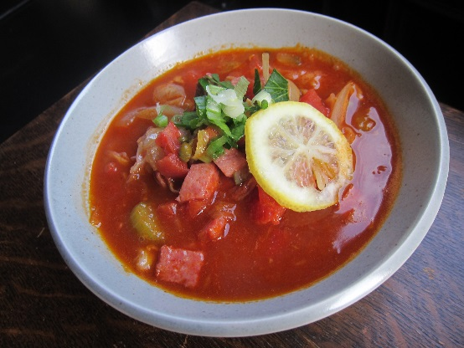



Russian Soup罗宋汤
一种浓菜汤，成汤后冷热兼可享用。
发源于乌克兰，在东欧或中欧很受欢迎。
在这些地区，罗宋汤大多以甜菜为主料，常加入马铃薯、红萝卜、菠菜、牛肉块、奶油等熬煮。
有些地方以番茄为主料，甜菜为辅料，也有不加甜菜的。

Slide 14
How do you make Russian soup?
First, buy some beef, one cabbage, four carrots, three potatoes, five tomatoes and one onion.
Then, cut up the vegetables.
Next, put the beef, carrots and potatoes into a pot.
Add some water.
After that, cook for 30 minutes.
Then, add the cabbage, tomatoes and onion.
Cook for another 10 minutes.
Finally, add some salt.

Slide 15
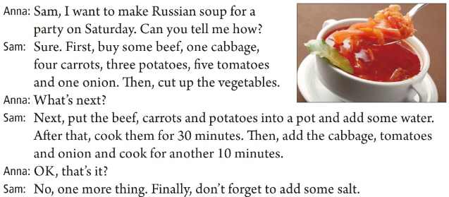
Listen and role-play the conversation.

Slide 16

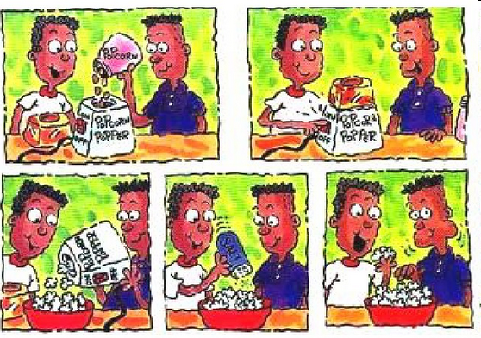
Look at the pictures.
corn
popcorn machine
popcorn
salt
How do we make popcorn?

Slide 17
Complete the questions first. Then match them with the answers.
___ 1. __________ do you make popcorn?
___ 2. __________ corn do we need?
___ 3. __________ do we do next?
___ 4. __________ salt do we need?
___ 5. Now can we eat it?
b
How
a
How much
d
What
e
How much
c
a. Half a cup.
b. ________, put the corn into the popcorn machine.
First
c. Yes, we can!
d. Next, _____ on the machine. ________, add the salt.
turn
Finally
e. Just one spoon.

Slide 18
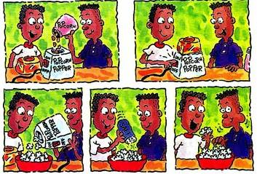
Let’s read the conversation.
A: How do you make popcorn?
B: First, put the corn into the popcorn machine.
A: How much corn do we need?
B: Half a cup.
A: What do we do next?
B: Next, turn on the machine. Finally, add the salt.
A: How much salt do we need?
B: Just one spoon.
A: Now can we eat it?
B: Yes, we can!

Slide 19


How do we do one of the following things? Write down or tell your classmates.
plant a tree make beef noodles wash clothes take out a book from the library

Slide 20

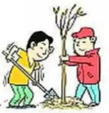
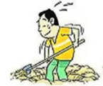
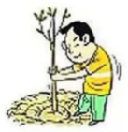
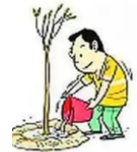
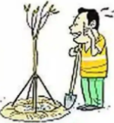
——Do you know how to plant a tree?
——First, ...
Then, put a tree in the hole.
Next, put the soil back into the hole and step on it.
First, dig a hole.
泥土
v. 挖
踩
Finally, water the tree.
It’s OK now. I’m finished.
v. 浇水

Slide 21
How do we make beef noodles?
First, pour some water into the pot.
First, turn on the fire/ induction cooker(电磁炉).
Then, boil(v.使煮沸) the water.
Then, add a teaspoon(茶匙) of oil.
Then, put the noodles in a pot.
After that, cook for 5 minutes.
Next, put the beef in the pot.
Cook for another 2 minutes.
Next, add some salt.
Finally, pour the beef noodles into the bowl. Let’s enjoy it.

Slide 22
Write how to do one of the following things. Then tell your partner how to do it.
plant a tree make beef noodles wash clothes take out a book from the library

Slide 24
How do you wash clothes?
First, prepare a bucket.
Then, turn on the tap.
Then, boil the water.
Then, add a teaspoon of oil.
Then, put the noodles in a pot.
After that, cook for 5 minutes.
Next, put the beef in the pot.
Cook for another 2 minutes.
Next, add some salt.
Finally, pour the beef noodles into the bowl. Let’s enjoy.

Slide 25
ingredient原料 | beef | watermelon | banana | orange | yogurt | honey | salad sauce
amount 数量

Slide 26
Finish the chart below.
How to make Russian soup
Ingredients |  | Amount
How many | cabbages | one
How much
carrots
four
potatoes
three
tomatoes
five
onions
one
beef
some

Slide 27
Read the conversation again and tell your partner how to make Russian soup.
First, _________________________
Then, _________________________
Next, _________________________
After that, _____________________
Then, _________________________
Finally, _______________________
Steps

Slide 28
Write how to do one of the following things. Then tell your partner how to do it.
plant a tree make beef noodles wash clothes take out a book from the library
v. 掘(地); 凿(洞); 挖(土)
First, dig a hole. Then …
Do you know how to plant a tree?
n. 洞；孔；坑

Slide 29



To learn to distinguish between Countable nouns and Uncountable nouns and describe their quantities
To learn How much and How many questions
To learn adverbs of sequence:
First … Next … Then … Finally …

Slide 30



Role-play the conversation with your partner.
First, peel …
Then, …
Next, cut up …
After that, …
Finally, …
How do you make a banana milk shake?

Slide 31
Pay attention to the words in black.
How do you make a banana milk shake? | First, peel the bananas. Next, put the bananas in the blender. Then, pour the milk into the blender. Finally, turn on the blender.
表示顺序的副词，可用来表达制作步骤的先后顺序。

Slide 32

祈使句的肯定式
1. 以实义动词原形开头。
e.g. Come here.
Look at the map.
2. 以动词be开头。
e.g. Be a good boy.
Be quiet, please.
3. 以Let开头。
e.g. Let me have a look.
Let’s go!
【注意】
有时可在祈使句的句首或句尾加上please，使语气显得客气、有礼貌。如果在句尾加please，应该用逗号与前句隔开。
e.g. Come in, please.

Slide 33

祈使句的否定式
1. 在动词原形前加don’t。
e.g. Don’t sit here.
Don’t be late.
2. 以let开头的祈使句, 其否定式有两种：一种是直接在句首加don’t; 另一种是“let +宾语+ not +动词原形+ (其他)”。
e.g. Don’t let him go.
Let Jim not play there.
【注意】
“No + 名词 /
动词-ing形式”表示禁止或规劝，常用于公共场所。
e.g. No photos!
No smoking！

Slide 34

Countable nouns
______ _______(多少) bananas do we need?
We need three bananas.
Uncountable nouns
______ _______(多少) yogurt do we need?
We need one cup of yogurt.
How many
How much

Slide 35

可数名词和不可数名词
名词按其所表示的事物的性质分为可数名词和不可数名词。请将下列单词归类。
banana, milk, salt, apple, salad, watermelon, yogurt, beef, honey, tomato, sandwich, chicken, ice-cream, fruit, juice
可数名词：
不可数名词：
既可作可数名词也可作不可数名词：
banana, apple, watermelon, tomato, sandwich
milk, salt, yogurt, beef, honey, juice
salad, chicken, ice-cream, fruit

Slide 36
可数名词和不可数名词的区别
1. 可数名词一般有单数形式和复数形式两种 (少数可数名词单复数同形, 如sheep, Chinese等); 不可数名词没有单、复数形式。
2. 数词或many, some, a lot of等可直接修饰可数名词, 表示数量; 要表达不可数名词的量要用“数词+表示量的名词(有单数、复数形式变化)+of ”。如：
two books one cup / bottle of water three spoons of honey
one bowl of rice one box of milk two kilos of yogurt

Slide 37
3. 对可数名词的量进行提问时用how many 。
(注意：how many后接可数名词的复数形式)；
对不可数名词的量进行提问时用how much。如：
This boy has three pens. (对划线部分提问)
→How many pens does this boy have?
I ate two bowls of rice. (对划线部分提问)
→How much rice did you eat?
how much 多少钱；询问价格
— How much is Kate’s sweater?
— 60 yuan.
【链接1】

Slide 38
【链接2】
有些名词既可以充当可数名词，也可以充当不可数名词，但是它们各自表达的意义有所不同。
例词 | 不可数名词 | 可数名词
food | 表示“食物” | 表示类别
fruit | 表示“水果”
ice-cream | 表示“冰激凌” | 表示份数
salad | 表示“沙拉”
chicken | 表示“鸡肉” | 表示“小鸡”
orange | 表示“橙汁；橙色” | 表示“橙子”

Slide 39

1. Tony’s father is a ________. (2020广西桂林)
teachers B. doctors C. driver
2. — Lisa, could you help me buy some ______ on your way home?
— OK, mom. (2021广西河池)
A. egg B. beef C. banana D. potato
C
B

Slide 40
3. — Thank you for the _____ you gave me.
— I'm glad they're helpful. (2021辽宁丹东)
A. suggestions B. advice C. news D. information
4. Sandy really likes eating meat, but she doesn’t like eating _______. (2020四川广元)
A. breads B. vegetables C. chickens
A
B

Slide 41

Do you know how to make popcorn?
First, ...
Next, …
Finally, …
And you can eat it now.

Slide 42


1. 根据生活经验，将如何做这些事情的过程写出来。
2. 恰当运用first, next, then, finally等表示事情顺序的词汇, 让你的描述更加清晰。

Slide 43


做爆米花
半杯
种树
挖洞
洗衣服
从图书馆借书
make popcorn
half a cup
plant a tree
dig a hole
wash clothes
take out a book from the library

Slide 44
可数名词和不可数名词
1. 可数名词有单复数之分。
2. 可数名词可直接和a / an或数词连用来表示具体的数量, 也可用 some / many / lots of / a lot of …+ 名词复数;
不可数名词前要用 “a / an或数词+表示量的名词(有单数、复数形式变化) + of”结构来表示具体的数量。
3. 对可数名词的量进行提问时用how many;
对不可数名词的量进行提问时用how much。

Slide 45


I. 根据括号内的要求完成下列各题，每空一词(含缩略形式)。
1. You should go to bed early tonight. (改为祈使句)
_______ _______ _______ _______ tonight.
2. You shouldn’t be afraid of her. (改为祈使句)
_______ _______ _______ _______ her.
3. They need three cups of juice. (对划线部分提问)
_______ _______ _______ _______ _______ do they need?
Go to bed early
Don’t be afraid of
How many cups of juice

Slide 46
4. My dog dug four holes under the tree. (对划线部分提问)
_______ _______ holes did your dog dig under the tree?
5. Sam ate two bowls of rice yesterday. (对划线部分提问)
_______ _______ _______ did Sam eat yesterday?
How many
How much rice

Slide 47
Ⅱ. 根据短文内容、所给首字母提示及括号内所给单词的提示填空。
These are Mr. Baker and Mrs. Baker. They are old farmers. Mr. Baker loves his wife (妻子) very much. Every day, Mr. Baker wakes up early. He usually works on the farm in the morning. (1)F , he milks the cow. (2)N , he feeds the chickens. He grows (3) (pumpkin) every year. So sometimes he plows the land (耕地). (4)T in the afternoon, he takes care of his (5) (horse) and (6) (pig).
First
Next
pumpkins
Then
horses
pigs

Slide 48
After dinner, Mr. Baker likes to take a walk around the village.
Tomorrow is his wife’s birthday. Mr. Baker drove to the nearest town. He bought some (7) (vegetable) and (8) (meat). He also bought two (9) (bag) of (10) (cheese). He planned to make sandwiches for his wife. They’re her favorite. Oh, one (11)m thing, he bought six (12) (banana) and lots of (13) (strawberry) to make a fruit salad. He hoped his wife would enjoy the dinner.
vegetables
meat
bags
cheese
more
bananas
strawberries

Slide 49


1. Review Grammar.
2. Choose one of the things in 3c, and then write how to do it.

Slide 50


